Slide 1

Sentiment Analysis of Financial Data
Shanthan Kumar Bine
Vennela Ramishetty
1

Slide 2
Objective
The objective is to analyze financial data and determine sentiment trends using natural language processing and machine learning techniques for sentiment classification.

Slide 3
AGENDA
The goal is to perform sentimental analysis using Naïve Bayes Algorithm. Sentimental Analysis is performed to gain insights and make informed decisions in the business. The following dataset is intended for advancing financial sentiment analysis research. It's two datasets (FiQA, Financial Phrase Bank) combined into one CSV file. It provides financial sentences with sentiment labels. The model is trained to make predictions and provide valuable insights.
3

Slide 4
STEPS
DATA PREPARATION
Start by gathering and preparing the training dataset. Check for missing values , Check for duplicate rows and preparing the dataset for model training.
FEATURE SELECTION AND DATA SPLITING
Identify the relevant features that will be used to classify the instances. Then split the data into two parts training set and testing set. The training set will be used to train the Naive Bayes model, while the validation set will be used to evaluate its performance. Then, Vectorizing the Text.
MODEL Training
After we fit the data, we train the model in this phase.
Model evaluation
Once the Naive Bayes model is trained, it is important to evaluate its performance. Use the validation set to measure how well the model predicts.
Visualization
We then Visualize the data to gain the insights identifying patterns effectively.

Slide 5
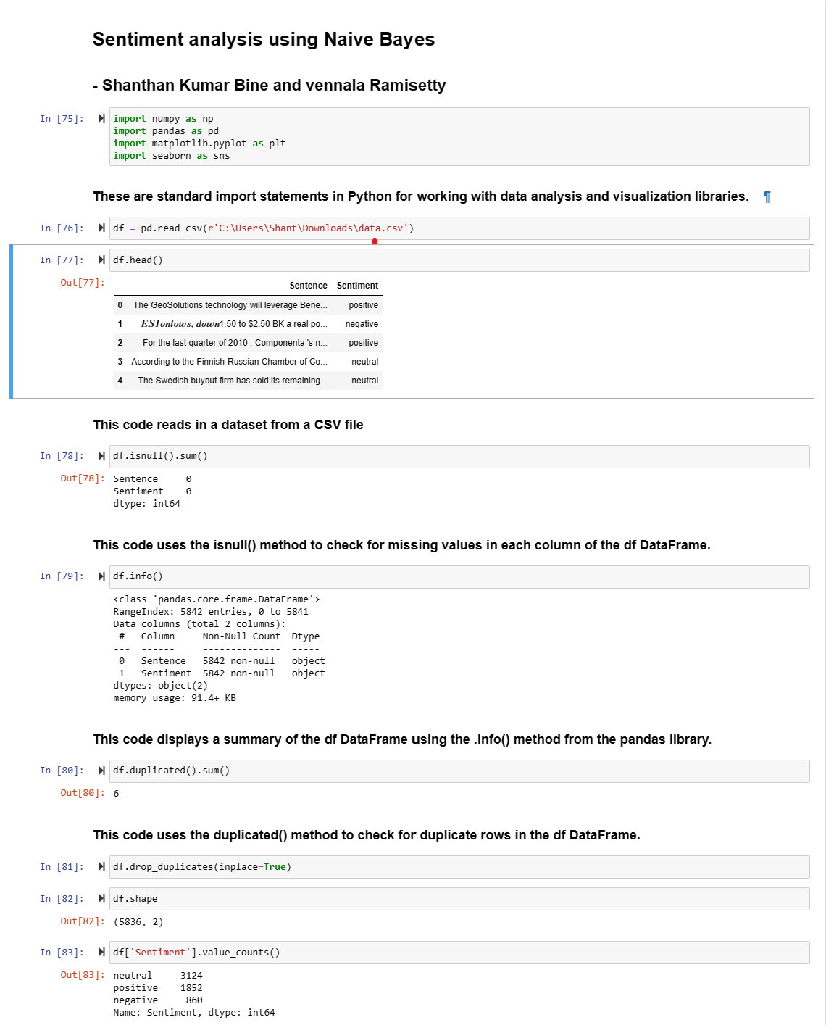
Data preparation
The given code performs data analysis and cleaning on a dataset. It's important to clean and prepare the data for model training.

Slide 6
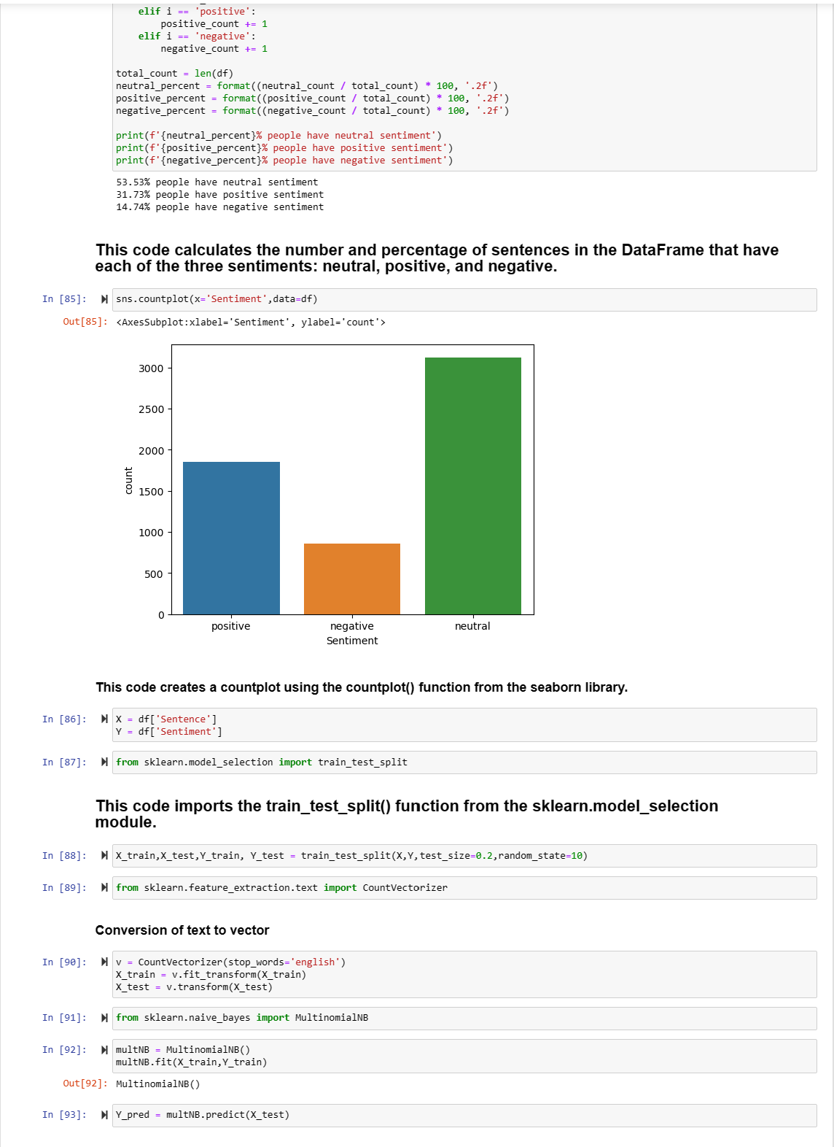
Feature Selection and data splitting
Feature selection is the process of selecting a subset of relevant features from the dataset to improve model performance and reduce complexity
Data Split: Split your data into two parts training set and a testing set. The training set will be used to train the Naive Bayes model, while the testing set will be used to evaluate its performance.
Vectorizing the Text: To work with textual data in machine learning models, it needs to be converted into numerical form.

Slide 7
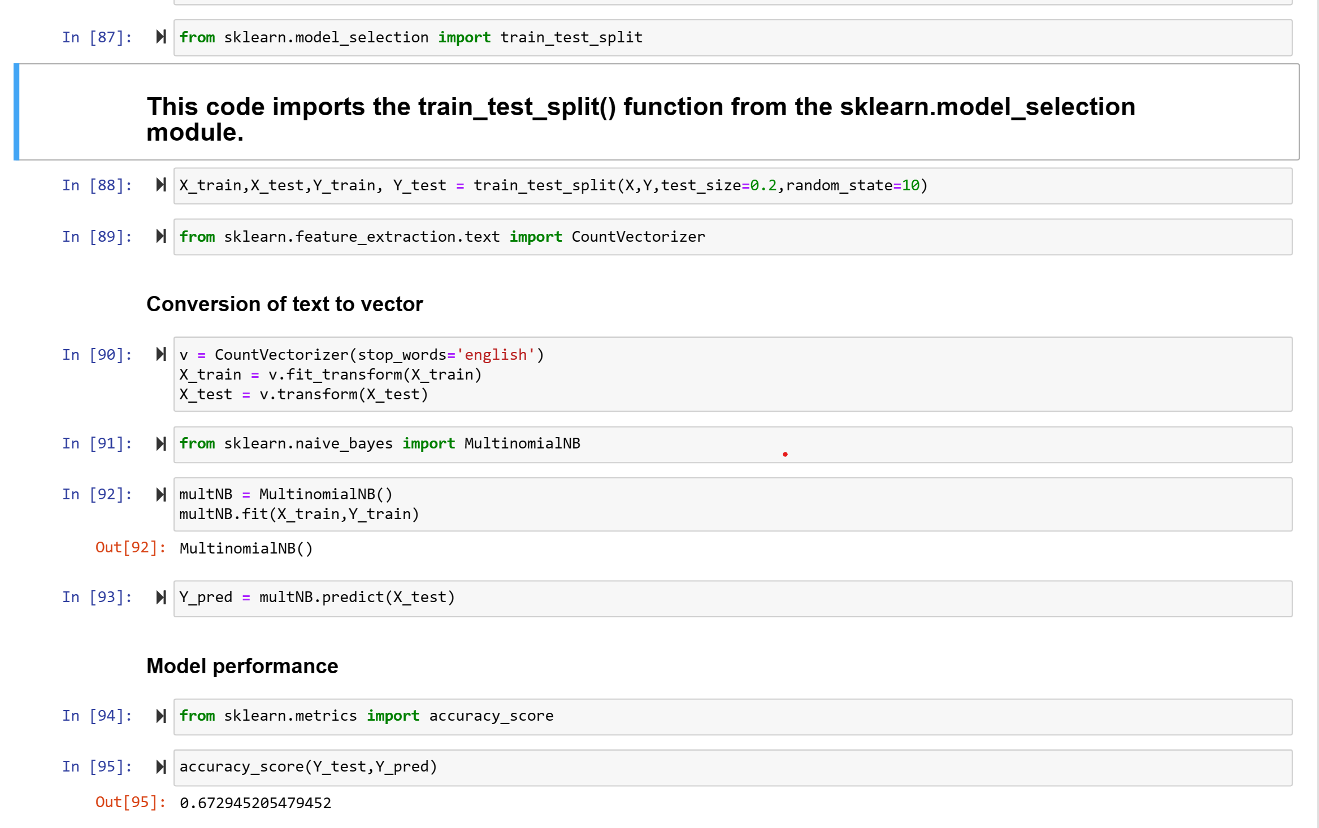
Model training
This code is performing text classification using the Naive Bayes algorithm.

Slide 8
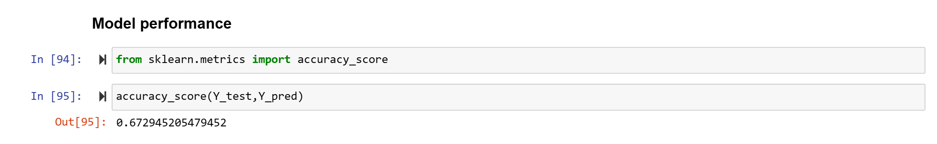
Model evaluation
Model evaluation is the process of assessing the performance and effectiveness of a machine learning model. It involves using various metrics and techniques to measure how well the model is performing on a given task. The goal of model evaluation is to gain insights into the model's strengths, weaknesses, and overall quality. The naïve bayes model we trained has got 67.29%.

Slide 9
Conclusion
The purpose of the code is to perform sentiment analysis using the Naive Bayes algorithm. It reads a dataset from a CSV file, preprocesses the data by handling missing values and duplicates, and then calculates the number and percentage of sentences with each sentiment category (neutral, positive, negative). It also visualizes the distribution of sentiments using a countplot. The code then splits the dataset into training and testing sets using the train_test_split() function from scikit-learn. It applies the CountVectorizer to convert the text data into numerical vectors. The MultinomialNB algorithm is used to train a Naive Bayes model on the training data and make predictions on the test data. Finally, the code calculates the accuracy score of the model's predictions. It provides insights into the distribution of sentiments and make informed decisions in the business.

Slide 10
THANK YOU
Shanthan Kumar Bine
Vennela Ramishetty

